Slide 1

Apply Yourself
TAKE FIVE
Michael Bien
Jennifer Darby
Jinah Porter
Debra Wu

Slide 2
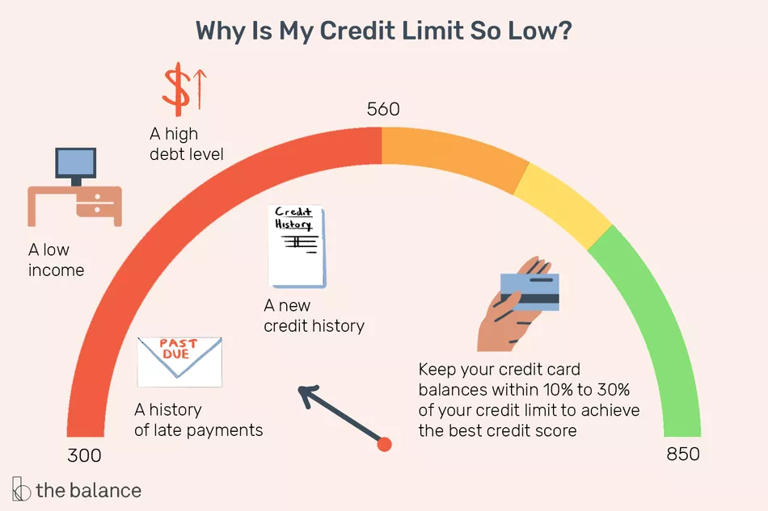
Credit Risk
In light of the recent pandemic, COVID-19, many people are struggling financially due to the loss of their job, lower hours or overtime pay.
Credit Card companies determine an applicant’s risk based upon multiple metrics. It is important to understand how these factors can predict one’s ability to pay.
Source | www.thebalance.com
Notes:
In this project, we addressed the main challenges of finding the appropriate dataset to model with binary classification.
We cleaned the dataset on credit application data from Kaggle. Ran both models and the Logistic Regression resulted in the best test score of 0.96.

Slide 3
Project Overview
We chose kaggle credit application and used two machine learning models for binary classification. The Logistic regression model returned 0.96, so we serialized the data using Python Pickle module and loaded our results using a flask server to a custom webpage
Notes:
Gender education marriage

Slide 4

Project Demo

